Slide 1
Digital Portfolio
STUDENT NAME: Vasanth. V
REGISTER NO AND NMID: astvu20920924u09209
DEPARTMENT: BCA
COLLEGE:Shanmuga Industries Arts & Science College/ Thiruvalluvar University

Slide 2
PROJECT TITLE
Portfolio wob pags tamplate with comtact form

Slide 3


AGENDA
Problem Statement
Project Overview
End Users
Tools and Technologies
Portfolio design and Layout
Features and Functionality
Results and Screenshots
Conclusion
Github Link
3/21/2024 Annual Review

Slide 4

PROBLEM STATEMENT
Many personal portfolios lack a clean, responsive design that works well on both desktop and mobile devices. This project solves that problem by creating a user-friendly and professional portfolio site.

Slide 5

PROJECT OVERVIEW
This is a personal portfolio website for showcasing skills, projects, and contact details. It is built using HTML, CSS, and JavaScript.

Slide 6

WHO ARE THE END USERS?
Recruiters and employers looking for my work. Clients who want to connect for freelance or project work. Visitors who want to know about my skills and projects.

Slide 7

TOOLS AND TECHNIQUES
HTML5 – structure of the site CSS3 – styling and responsive design JavaScript – interactivity (menu toggle, form validation)

Slide 8
POTFOLIO DESIGN AND LAYOUT
Header with logo and navigation Hero section with introduction About section describing skills Projects section with cards Contact form for communication Footer with copyright
8

Slide 9
FEATURES AND FUNCTIONALITY
Responsive navigation with mobile menu Contact form with validation Smooth layout and simple design Project cards for easy display of work

Slide 10


RESULTS AND SCREENSHOTS
3/21/2024 Annual Review
10

Slide 11
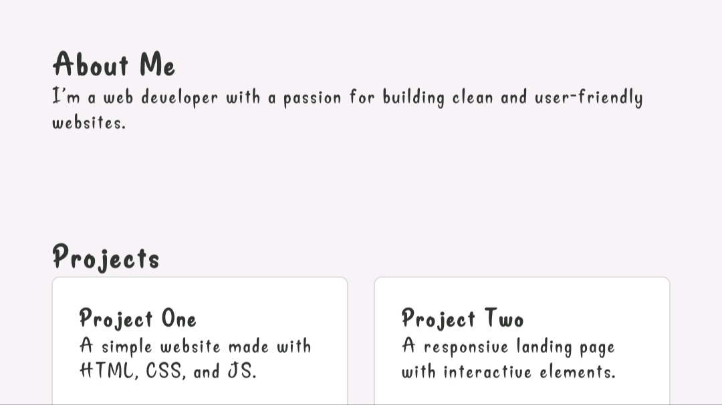
RESULTS AND SCREENSHOTS

Slide 12
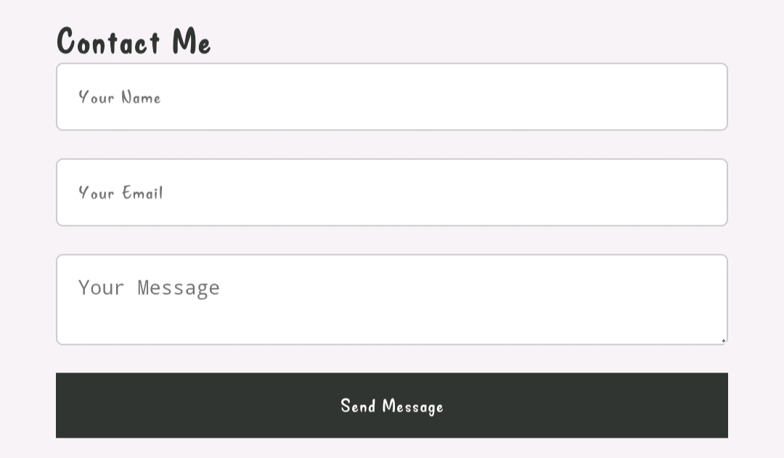
RESULTS AND SCREENSHOTS

Slide 13
CONCLUSION
This portfolio website provides a professional online presence, making it easy for recruiters, clients, and visitors to learn about me, my work, and how to get in touch.
13

